Slide 1
Systems Development Life Cycle
Objectives
How to build the computer based information system
What are the different steps in system development life cycle
What prompts users to change their request
What are the various components of feasibility study
•What are the factors to consider in a candidate system

Slide 2
System Development Life Cycle
System Development Life Cycle (SDLC) The system development life cycle is classically thought of as the set of activities that analysts, designers and users carry out to develop and implement an information system.
(SDLC) is the process of understanding how an information system (IS) can support business needs, designing the system, building it, and delivering it to users.
The key person in the SDLC is the systems analyst who analyzes the business situation, identifies opportunities for improvements, and designs an information system to implement them

Slide 3
The system analyst gives a system development project meaning & direction. A candidate system is modelled after the analyst has gone a thorough understanding of user requirements & problems.
NB: Usually systems often cut across the boundaries of users in the organization. For example, a billing system may involve users in the sales order department, the credit department, the warehouse and the accounting department. To make sure that all users’ needs are met, a project team with all the units of the organization.is formed that represents each unit works with the SAD team to carryout a system development project.
Notes:
Being a systems analyst is one of the most interesting,
exciting, and challenging jobs around. As a systems analyst, you will work with a
variety of people and learn how they conduct business. Specifically, you will work
with a team of systems analysts, programmers, and others on a common mission. You will feel the satisfaction of seeing systems that you designed and developed
make a significant business impact, while knowing that your unique skills helped
make that happen.
It is important to remember that the primary objective of the systems analyst
is not to create a wonderful system. The primary goal is to create value for the
organization, which for most companies means increasing profits (government
agencies and not-for-profit organizations measure value differently).

Slide 4
The Systems Development Life Cycle (SDLC)
Notes:
In many ways, building an information system is similar to building a house. First,
the house (or the information system) starts with a basic idea. Second, this idea is
transformed into a simple drawing that is shown to the customer and refined (often
through several drawings, each improving on the other) until the customer agrees
that the picture depicts what he or she wants. Third, a set of blueprints is designed
that presents much more detailed information about the house (e.g., the type of
water faucets, where the telephone jacks will be placed). Finally, the house is built
following the blueprints—and often with some changes and decisions made by the
customer as the house is erected.

Slide 5
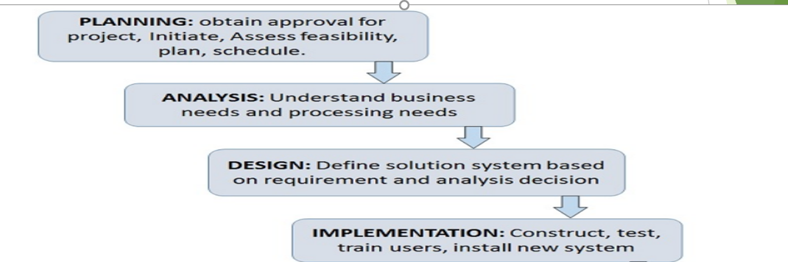
SDLC Phases

Slide 6
SDLC PHASES
Phases of SDLC
Each phase is composed of a series of steps or activities, which rely on techniques that produce deliverables such as specific documents and files that provide understanding about the project.
Notes:
For example, when you apply for admission to a university, there are several
phases that all students go through: information gathering, applying, and accepting.
Each of these phases has steps: information gathering includes steps like searching
for schools, requesting information, and reading brochures. Students then use techniques
(e.g., Internet searching) that can be applied to steps (e.g., requesting information)
to create deliverables (e.g., evaluations of different aspects of universities).
For now, there are two important points to understand about the SDLC. First,
you should get a general sense of the phases and steps that IS projects move through
and some of the techniques that produce certain deliverables. Second, it is important
to understand that the SDLC is a process of gradual refinement. The deliverables
produced in the analysis phase provide a general idea of the shape of the new system. These deliverables are used as input to the design phase, which then refines them to produce a set of deliverables that describes in much more detailed terms exactly how the system will be built. These deliverables in turn are used in the
implementation phase to produce the actual system. Each phase refines and elaborates
on the work done previously.

Slide 7
Phase 1.

Slide 8
Planning Phase
Notes:
Most ideas for new systems come from outside the IS area (from the marketing department,
accounting department, etc.) in the form of a system request.

Slide 9
NB:
Most ideas for new ideas for systems development come from outside the IT or IS department. It mostly comes from other units as a System Request. A system request presents a brief summary of a business need, and it explains how a system that supports the need will create business value.
The IS or IT department works together with the person or department that generated the request (called the project sponsor) to conduct a feasibility analysis

Slide 10
Feasibility Studies
The feasibility analysis examines key aspects of the proposed project:
The technical feasibility (Can we build it?)
The economic feasibility (Will it provide business value?)
The organizational feasibility (If we build it, will it be used?)
The system request and feasibility analysis are presented to an information systems approval committee (sometimes called a steering committee), which decides whether the project should be undertaken.
Notes:
Once the project is approved, it enters project management. During project management,
the project manager creates a workplan, staffs the projects, and puts
techniques in place to help the project team control and direct the project
through the entire SDLC. The deliverable for project management is a project
plan that describes how the project team will go about developing the system.

Slide 11
Phase 2: Analysis

Slide 12
Notes:
The next step is requirements gathering (e.g., through interviews or questionnaires).
The analysis of this information—in conjunction with input from the
project sponsor and many other people—leads to the development of a concept
for a new system.
The system concept is then used as a basis to develop a set of
business analysis models that describes how the business will operate if the new
system were developed. The set of models typically includes models that represent
the data and processes necessary to support the underlying business process.

Slide 13
Notes:
The analyses, system concept, and models are combined into a document called
the system proposal,
The system proposal is the initial deliverable that describes what business
requirements the new system should meet. Because it is really the first step in the
design of the new system, some experts argue that it is inappropriate to use the term
analysis as the name for this phase; some argue a better name would be analysis
and initial design.

Slide 14
Phase 3: Design
Notes:
Although
most of the strategic decisions about the system were made in the development of
the system concept during the analysis phase, the steps in the design phase determine
exactly how the system will operate. The design phase has four steps:

Slide 16
Design
This collection of deliverables (architecture design, interface design, database and file specifications, and program design) is the system specification that is handed to the programming team for implementation
Notes:
At the end of the design phase, the feasibility analysis and project plan are reexamined and revised, and
another decision is made by the project sponsor and approval committee about
whether to terminate the project or continue.

Slide 17
Phase 4: Implementation
Notes:
This is the phase that usually gets the most attention, because for most systems it is the
The Systems Development Life Cycle 7
001-027_dennis3e_01.qxd 10/7/05 10:20 AM Page 7
longest and most expensive single part of the development process.

Slide 18
Three Implementation Steps
Notes:
Since the cost of bugs can be immense, testing is one of the most critical steps in implementation. Most organizations spend more time
and attention on testing than on writing the programs in the first place.
Installation is the process by which the old system is
turned off and the new one is turned on. It may include a direct cutover approach
(in which the new system immediately replaces the old system), a parallel conversion
approach (in which both the old and new systems are operated for a
month or two until it is clear that there are no bugs in the new system), or a
phased conversion strategy (in which the new system is installed in one part of
the organization as an initial trial and then gradually installed in others).
One of
the most important aspects of conversion is the development of a training plan
to teach users how to use the new system and help manage the changes caused
by the new system.
The analyst team establishes a support plan for the system. This plan usually
includes a formal or informal post-implementation review, as well as a systematic
way for identifying major and minor changes needed for the system.

Slide 21
Notes:
Data-centered methodologies utilize data models (Chapter 7) as the core of the system concept. For example, analysts
concentrate initially on identifying the data that must be available to produce the payroll and organizing that data into well-defined structures (e.g., employee work
log, employee pay rates, payroll tax tables, employee pay history, etc.).

Slide 22
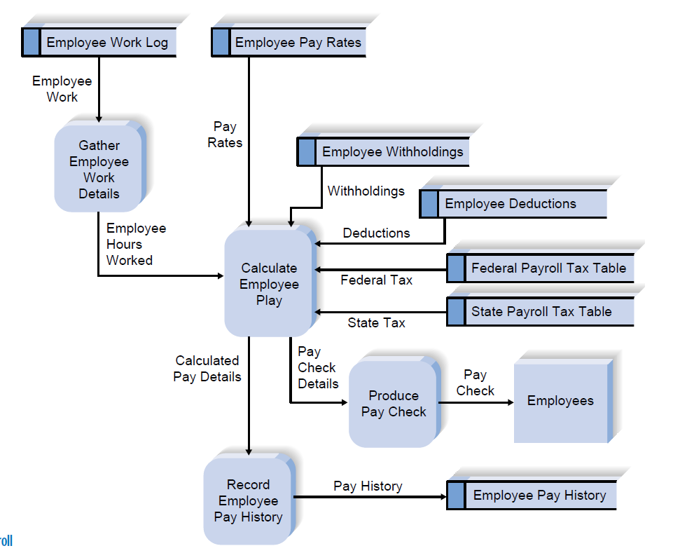

Slide 24
Methodology Categories
Another important factor in categorizing methodologies is the sequencing of the SDLC phases and the amount of time and effort devoted to each.
The three major categories of systems development methodologies that have evolved over time:
Structured Design,
Rapid Application Development (RAD)
Agile Development.
Each category represents a collection of methodologies that attempts to improve on previous practice, and varies in terms of the progression through the SDLC phases and the emphasis placed on each phase.
Notes:
4 In the early days of computing, the need for formal and well-planned life cycle methodologies was not well understood. Programmers tended to move directly from a very simple planning phase right into the construction step of the implementation phase;
This is the same approach that you may sometimes use when writing programs
for a programming class. It can work for small programs that require only
one programmer, but if the requirements are complex or unclear, you may miss
important aspects of the problem and have to start all over again, throwing away
part of the program (and the time and effort spent writing it). This approach also
makes teamwork difficult because members have little idea about what needs to be
accomplished and how to work together to produce a final product.

Slide 25
Structured Design Methodologies

Slide 26
Notes:
The key deliverables for each phase are typically voluminous
(often hundreds of pages in length) and are presented to the project sponsor for
approval as the project moves from phase to phase. Once the sponsor approves the
work that was conducted for a phase, the phase ends and the next one begins

Slide 31
Category 2: Rapid Application Development

Slide 33
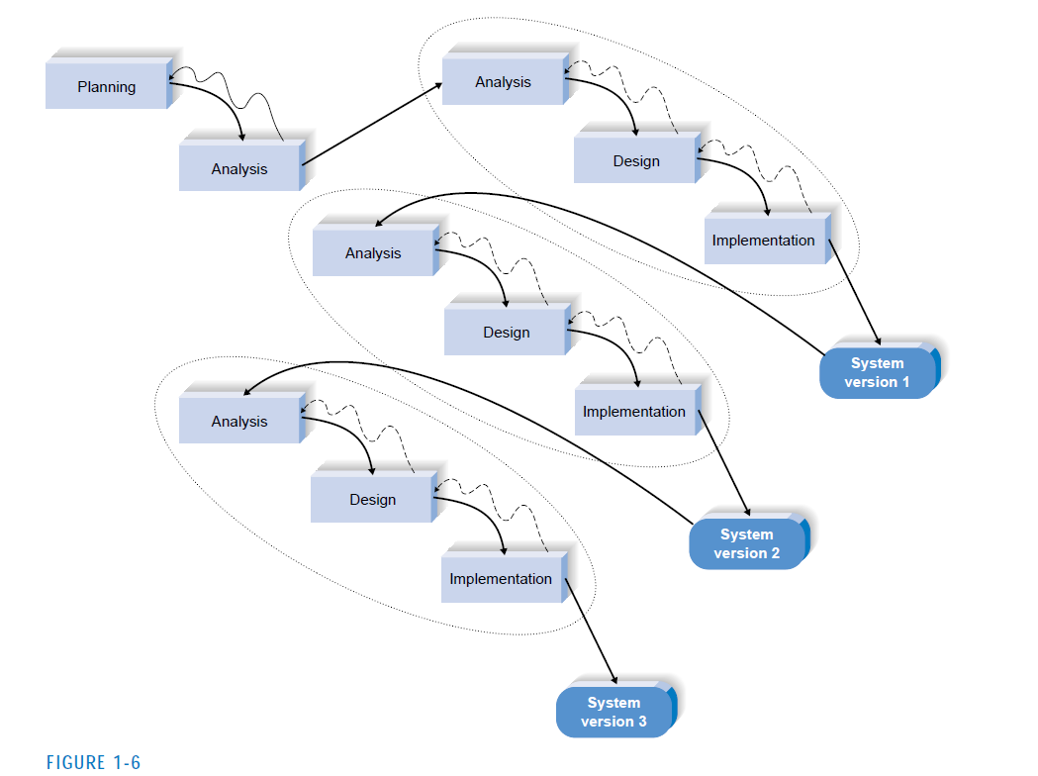

Slide 34
Notes:
With these methodologies, a basic analysis and design are performed, and work immediately begins on a system
prototype, a “quick-and-dirty” program that provides a minimal amount of
features. The first prototype is usually the first part of the system that the user
will use. This is shown to the users and the project sponsor, who provide reaction
and comments. This feedback is used to reanalyze, redesign, and reimplement a
second prototype that provides a few more features. This process continues in a
cycle until the analysts, users, and sponsor agree that the prototype provides
enough functionality to be installed and used in the organization

Slide 35
Advantages of Prototyping
The key advantage of a prototyping-based methodology is that it very quickly provides a system for the users to interact with, even if it is not initially ready for widespread organizational use. Prototyping reassures the users that the project team is working on the system (there are no longer time intervals in which the users perceive little progress), and the approach helps to more quickly refine real requirements
Notes:
Rather than attempting to understand system specification materials, the
users can interact with the prototype to better understand what it can and cannot do.

Slide 37
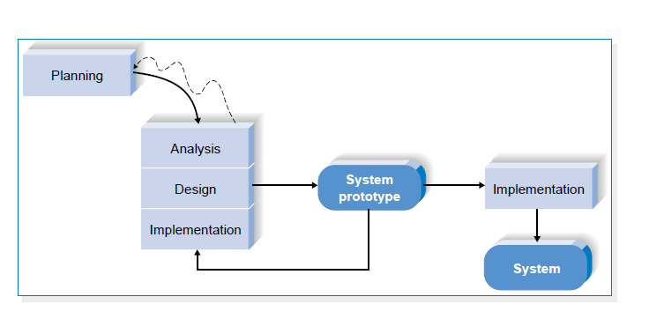

Slide 39
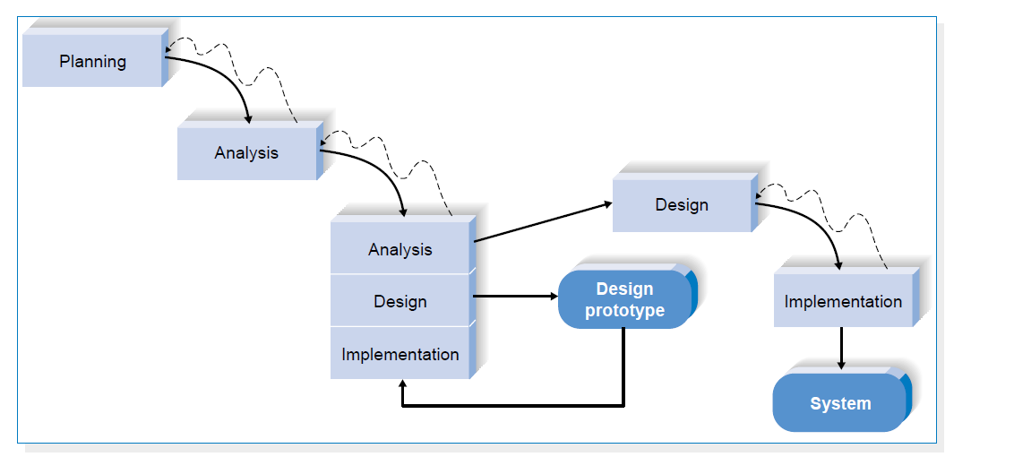
Notes:
Each of these issues is examined by analyzing, designing, and building a design prototype.
A design prototype is not a working system; it is a product that represents a part of
the system that needs additional refinement, and it contains only enough detail to enable users to understand the issues under consideration.
For example, suppose
users are not completely clear on how an order entry system should work. The analyst
team might build a series of HTML pages viewed using a Web browser to help
the users visualize such a system.

Slide 40
Category 3: Agile Development

Slide 41
Extreme Programming: XP

Slide 44
Draw certain specifications which are easily understood by users and programmer in precise and detailed form.
Implement the logical design of system which must be modular.
Plan the periodicity for evaluation after it has been used for some time, and modify the system as needed.

Slide 45
Main Roles
Defining and understanding the requirement of user through various Fact finding techniques.
Prioritizing the requirements by obtaining user consensus.
Gathering the facts or information and acquires the opinions of users.
Maintains analysis and evaluation to arrive at appropriate system which is more user friendly.
Suggests many flexible alternative solutions, pick the best solution, and quantify cost and benefits.

Slide 46
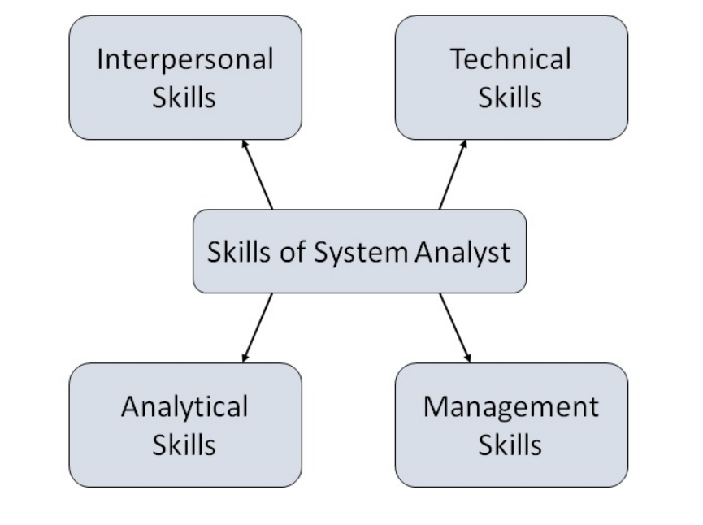
Attributes of a Systems Analyst
The following figure shows the attributes a systems analyst should possess −

Slide 47
Role of SA
Role of System Analyst
The system analyst is a person who is thoroughly aware of the system and guides the system development project by giving proper directions. He is an expert having technical and interpersonal skills to carry out development tasks required at each phase.
He pursues to match the objectives of information system with the organization goal.

